Slide 1
Customize using the SharePoint Framework (SPFx)
Speaker Name

Slide 3
Objectives
After completing this lesson, you will be able to:
Understand SPFx client-side solutions and Add-ins
The configuration settings and options for SPFx client-side solutions and Add-ins
How to provision an App Catalog
The importance of managing SPFx solutions and add-ins within your SharePoint Online environment and ways to control your end user’s ability to download and use add-ins from the SharePoint Store

Slide 4
Introduction to the SharePoint Framework (SPFx)

Slide 5

What Is the SharePoint Framework?
It is a page and web part model that provides full support for client-side SharePoint development and user interface extensibility
It allows for a structured and supported approach to enrich and extend the user interface of SharePoint by using client-side frameworks with initial support for client-side web parts
It is built from the ground-up using a modern web stack that uses TypeScript/JavaScript, HTML, and CSS in which all parts are executed in the end-user's browser
It is platform-agnostic and works on PC and Mac and is based on open-source technologies such as Node.js, Gulp, Webpack, and Yeoman
SPFx web parts are executed client-side and can work with data in SharePoint, in Microsoft 365 via the Microsoft Graph, or even by using your own custom Web APIs that use standard OAuth and REST methods
Notes:
The SharePoint Framework (SPFx) is a page and web part model that provides full support for client-side SharePoint development, easy integration with SharePoint data, and support for open source tooling. With the SharePoint Framework, you can use modern web technologies and tools in your preferred development environment to build productive experiences and apps that are responsive and mobile-ready from day one. The SharePoint Framework works for SharePoint Online and also for on-premises (SharePoint 2016 Feature Pack 2 and SharePoint 2019).
Key features of the SharePoint Framework include the following:
It runs in the context of the current user and connection in the browser. There are no iFrames for the customization (JavaScript is embedded directly to the page).
The controls are rendered in the normal page DOM.
The controls are responsive and accessible by nature.
It enables the developer to access the lifecycle in addition to render, load, serialize and deserialize, configuration changes, and more.
It is framework-agnostic. You can use any JavaScript framework that you like: React, Handlebars, Knockout, Angular, and more.
The toolchain is based on common open source client development tools such as npm, TypeScript, Yeoman, webpack, and gulp.
Performance is reliable.
End users can use SPFx client-side solutions that are approved by the tenant administrators (or their delegates) on all sites, including self-service team, group, or personal sites.
SPFx web parts can be added to both classic and modern pages.
The runtime model improves on the Script Editor web part. It includes a robust client API, an HttpClient object that handles authentication to SharePoint and Microsoft 365, contextual information, easy property definition and configuration, and more.
If you work primarily with C#, you want to learn more about client-side JavaScript development. Most of your existing JavaScript knowledge related to SharePoint, however, is completely transferable, as the data models have not changed, and you’ll use the same REST services or JavaScript Object Model (JSOM), depending on your requirements. If you are a C# developer, TypeScript is a nice transition into the JavaScript world. The choice of IDE is up to you. Many developers like to use the cross-platform IDE Visual Studio Code. Many developers also use products like Sublime and ATOM. Use what works best for you.

Slide 6
Key features of SPFx
It runs in the context of the current user and connection in the browser. There are no iFrames for the customization (JavaScript is embedded directly to the page).
The controls are rendered in the normal page DOM and the controls are responsive and accessible by nature
It is framework-agnostic. You can use any JavaScript framework that you like: React, Handlebars, Knockout, Angular, and more.
The toolchain is based on common open-source client development tools such as npm, TypeScript, Yeoman, webpack, and gulp
End users can use SPFx client-side solutions that are approved by the tenant administrators (or their delegates) on all sites, including self-service team, group, or personal sites
Performance is reliable and SPFx web parts can be added to both classic and modern pages

Slide 7
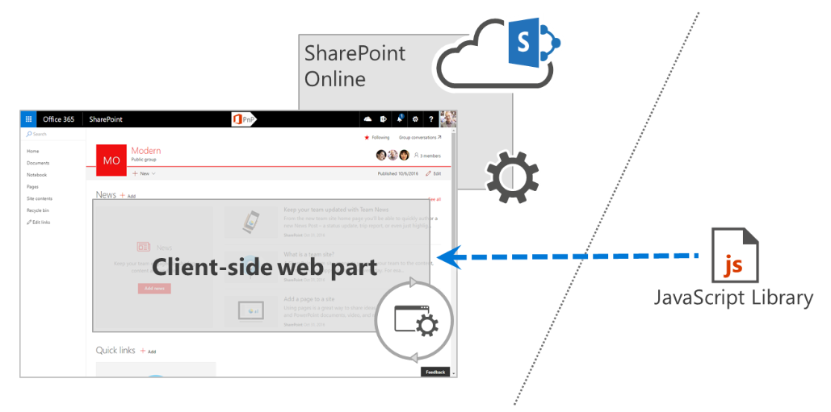
Parts of SharePoint Framework solutions
SPFx solutions consist of two parts: code (often referred to as a web part bundle) deployed to a URL, and an .sppkg file that contains a web part manifest with a URL pointing to the location where the web part code is deployed
Organizations can choose to have their SPFx web parts deployed to the Microsoft 365 public CDN, Azure storage, or a privately-owned web server.
Notes:
SharePoint Framework solutions consist of two parts: code (often referred to as a web part bundle) deployed to a URL, and an .sppkg file that contains a web part manifest with a URL pointing to the location where the web part code is deployed. There are no restrictions to where the code is deployed, as long as users working with the web part can access the web part code. Organizations can choose, for example, to have their web parts deployed to the Microsoft 365 public CDN, Azure storage, or a privately-owned web server.

Slide 8
SharePoint Framework Solutions Governance
SPFx solutions are executed as a part of the page in the context of the current user
Whatever the user can do, the web part's code can do as well
SharePoint administrators should treat SharePoint Framework solutions as high-trust solutions
They are considered full trust client-side code solutions, without any resource restrictions, that it execute under the users' context
The location where web part assets (.js, .png, .css, etc.) are stored is important for several reasons
Is the code-hosting location supported by the organization?
Who manages the code-hosting location?
What is the SLA for the hosting location?
Is the hosting location optimized for performance?
Notes:
Web part code-hosting location considerations
The most important thing that organizations should know before deploying SharePoint Framework solutions is where the code of the solution is deployed. SharePoint Framework solutions are executed as a part of the page in the context of the current user. As a result, whatever the user can do, the web part's code can do as well. In contrast to SharePoint Add-ins, there is no separate permission scope applied to SharePoint Framework solutions. This is why SharePoint administrators should treat SharePoint Framework solutions as high-trust solutions, the same way they treat farm solutions on-premises. The location where the web part's code is deployed is important for a number of reasons.
Consider the following location issues.
Is the code-hosting location supported by the organization?
SharePoint Framework doesn't impose any restrictions regarding where the solution's code is deployed. As a result, developers and vendors can deploy the code to a range of locations within or outside the organization's IT department. Different organizations may have different server requirements ranging from access policies to SLAs. Before deploying a SharePoint Framework solution package, organizations should ensure that the server used to host the code is a known server approved to be used by the organization.
Who manages the code-hosting location?
SharePoint Framework solutions execute as a part of the page in the context of the current user. While an organization could perform a code review before deploying a solution package, to verify that the code can be trusted, it also should ensure the integrity of the code as long as it's deployed to the tenant. Organizations should have a clear understanding of who manages the hosting location, who and under what circumstances they can modify the files, and what the update approval process looks like. Establishing this information upfront not only helps organizations control the update process, but also lowers the risk of deploying malicious code.
What is the SLA for the hosting location?
When organizations use Microsoft 365 and SharePoint Online, they rely on the SLA provided by Microsoft. SharePoint Framework solutions that extend the standard capabilities of SharePoint and Microsoft 365 should be deployed to servers that meet or exceed the SLA provided by Microsoft. That way, organizations can ensure that they are able to truly benefit from the added values of their customizations.
Is the hosting location optimized for performance?
Loading existing libraries from a URL instead of embedding them in the web part bundle is the first step to speed up the loading time of SharePoint Framework solutions. To get the most out of it, you want to ensure that the server hosting the different scripts is correctly configured for optimal performance. It should serve all files compressed, and the longer it allows proxies and clients to cache the files, the longer users will be able to load these scripts from their local cache, significantly speeding up loading SharePoint pages containing web parts.

Slide 9
Default hosting of SPFx web part assets
The package-solution.json file within an SPFx web part solution defines the package metadata as shown in the following code:
{
"$schema": "https://developer.microsoft.com/json-schemas/spfx-build/package-solution.schema.json",
"solution": {
"name": "helloword-webpart-client-side-solution",
"id": "3c1af394-bbf0-473c-bb7d-0798f0587cb7",
"version": "1.0.0.0",
"includeClientSideAssets": true,
"isDomainIsolated": false
},
"paths": {
"zippedPackage": "solution/helloword-webpart.sppkg"
}
}
The default value for includeClientSideAssets is true
When includeClientSideAssets is true the assets are automatically hosted when the solution is deployed to your tenant.
If Microsoft 365 CDN is enabled in the tenant, it is automatically used to store and serve the assets
If Microsoft 365 CDN is not enabled, assets are stored and served from the app catalog site collection’s /ClientSideAssets library
Notes:
The package-solution.json file within an SPFx web part solution defines the package metadata as shown in the following code:
JSONCopy
{ "$schema": "https://developer.microsoft.com/json-schemas/spfx-build/package-solution.schema.json", "solution": { "name": "helloword-webpart-client-side-solution", "id": "3c1af394-bbf0-473c-bb7d-0798f0587cb7", "version": "1.0.0.0", "includeClientSideAssets": true, "isDomainIsolated": false }, "paths": { "zippedPackage": "solution/helloword-webpart.sppkg" } }
The default value for the includeClientSideAssets is true, which means that static assets are packaged automatically inside of the .sppkg files, and you do not need to separately host your assets from an external system.
If you do not change this setting, the assets are automatically hosted when solution is deployed to your tenant.
If Microsoft 365 CDN is enabled, it is used automatically with default settings. If Microsoft 365 CDN is not enabled, assets are served from the app catalog site collection. This means that if you leave the includeClientSideAssets setting true, your solution assets are automatically hosted in the tenant.

Slide 10
Hosting options for your web part assets
By default, SPFx web part assets will be stored in, and served from, the app catalog
Each web part’s assets are stored in their own folder within the /ClientSideAssets library
Microsoft 365 CDN
Azure CDN
Another SharePoint online site
Any location that end users can access using HTTP(S) would be technically suitable for hosting the assets for end users
Host your client-side web part from Microsoft 365 CDN
https://docs.microsoft.com/en-us/sharepoint/dev/spfx/web-parts/get-started/hosting-webpart-from-office-365-cdn
Deploy your SharePoint client-side web part to Azure CDN
https://docs.microsoft.com/en-us/sharepoint/dev/spfx/web-parts/get-started/deploy-web-part-to-cdn
Add an external library to your SharePoint Framework client-side web part
https://docs.microsoft.com/en-us/sharepoint/dev/spfx/web-parts/basics/add-an-external-library
Notes:
There are multiple different hosting options for your web part assets. This tutorial concentrates on showing the Microsoft 365 CDN option, but you could also use the Azure CDN or simply host your assets from SharePoint library from your tenant. In the latter case, you would not benefit from the CDN performance improvements, but that would also work from the functionality perspective. Any location that end users can access using HTTP(S) would be technically suitable for hosting the assets for end users.
See Host your client-side web part from Microsoft 365 CDN
https://docs.microsoft.com/en-us/sharepoint/dev/spfx/web-parts/get-started/hosting-webpart-from-office-365-cdn
Deploy your SharePoint client-side web part to Azure CDN
https://docs.microsoft.com/en-us/sharepoint/dev/spfx/web-parts/get-started/deploy-web-part-to-cdn
Add an external library to your SharePoint client-side web part
https://docs.microsoft.com/en-us/sharepoint/dev/spfx/web-parts/basics/add-an-external-library

Slide 11
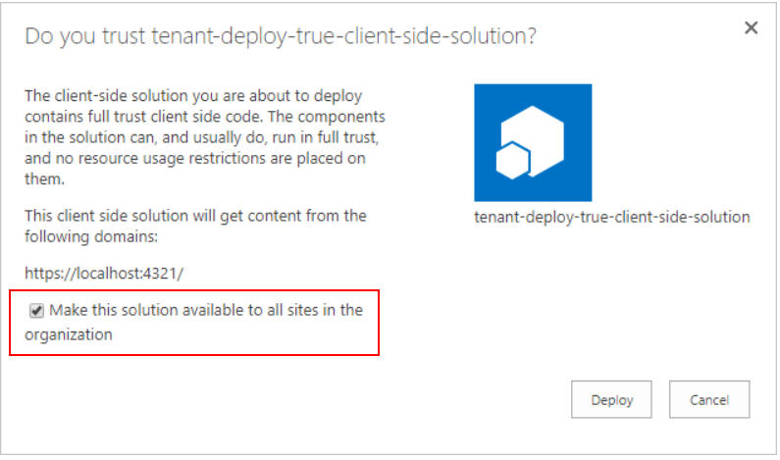
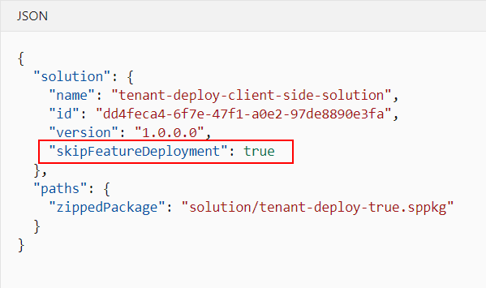
Tenant-scoped SPFx solution deployment
SPFx components can be configured to be immediately available across the tenant when the solution package is installed to the tenant app catalog
This can be configured during solution development by using the skipFeatureDeployment attribute in the package-solution.json file
When a solution with the skipFeatureDeployment = true is deployed to the tenant app catalog, the administrator is given an option to configure the solution to be deployed centrally across the tenant
Web parts are then immediately visible in the web part picker in both classic and modern pages.
Notes:
You can configure your SharePoint Framework components to be immediately available across the tenant when the solution package is installed to the tenant app catalog. This can be configured by using the skipFeatureDeployment attribute in the package-solution.json file.
When the solution has this attribute enabled, the tenant administrator is provided the option to enable the solution to be available automatically across all site collections and sites in the tenant when the solution package is installed to the tenant app catalog.
Approving tenant-wide deployment in app catalog
When the solution with the skipFeatureDeployment attribute set to true is deployed to the tenant app catalog, the administrator is given an option to configure the solution to be deployed centrally across the tenant.
By default, the Make this solution available to all sites in the organization check box is not selected. If the check box is selected by the administrator, components in the solutions are automatically visible and available across the tenant.
Client-side web part visibility on SharePoint sites
Web parts included in solutions that have been centrally deployed are immediately visible in the web part picker in both classic and modern pages.

Slide 12
Introduction to Add-ins

Slide 13
What Is an Add-in?
Formally know as Apps, Add-ins are self-contained pieces of functionality that extend the capabilities of a SharePoint website
They are targeted, lightweight, and easy-to-use, and do a great job at solving a user’s needs.
Add-in deployed features are not visible outside of the add-in
End users cannot manipulate an Add-in web preventing them from breaking the add-in using a browser or Microsoft SharePoint Designer
Users discover and download add-ins from the SharePoint Store or from their tenant’s private App Catalog and install them on their SharePoint sites
Notes:
SharePoint introduces a Cloud Add-in Model that enables you to create add-ins. Add-ins for SharePoint are self-contained pieces of functionality that extend the capabilities of a SharePoint website. In its most basic form, an add-in for SharePoint is a web application that is registered with SharePoint by using an add-in manifest. An add-in manifest is an XML file that declares the basic properties of the add-in along with where the add-in will run, and what to do when the add-in is started.
Add-ins integrate the best of the web and SharePoint Online. They are targeted, lightweight, and easy-to-use, and do a great job at solving a user need. Users discover and download add-ins from the SharePoint Store or from their organization's private App Catalog and install them on their SharePoint sites.
For example, suppose you have a SharePoint site to collaborate with a team, and you want to create a survey to gather more data. In SharePoint, you get a survey add-in from the SharePoint Store or from the App Catalog and install it on your site. Another example would be a mortgage broker, who sets up a website with add-ins from the SharePoint Store. These add-ins might include a bank rates add-in that helps find the best mortgage rates, a mortgage calculator add-in that helps calculate mortgage payments, and a property value estimator add-in that provides an approximate value of a property. The website might also include add-ins from the mortgage company’s App Catalog that help the mortgage broker to view and update client details and initiate a mortgage loan for a client.

Slide 14
Types of Add-in
There are two different types of add-ins for SharePoint, based on where the code for the add-in is hosted:
SharePoint-Hosted
Centered around SharePoint components including lists, pages, Web Parts, Workflows, libraries, and more
Business logic is JavaScript on custom pages
No server-side code
Provider-hosted
Centered around remote web application or data source
Business logic is mainly remote server-side code
Can include SharePoint Components.
Notes:
SharePoint-Hosted Add-ins
SharePoint-hosted add-ins for SharePoint are installed on an SharePoint Online website, called the host Web, and have their resources hosted on an isolated subsite of a host Web, called the Add-in Web. This approach enables you to reuse common SharePoint artifacts, such as lists and Web Parts. When you take this approach, you can use only JavaScript and you cannot use any server-side code.
Benefit: This approach enables you to reuse common SharePoint artifacts, such as lists and Web Parts.
Consideration: You can use only JavaScript in the add-in, and you cannot use any server-side code.
For more information, see: How to: Create a basic SharePoint-hosted (http://msdn.microsoft.com/en-us/library/fp142379.aspx)
Provider-Hosted Add-ins for SharePoint
Provider-hosted add-ins for SharePoint include components that are deployed and hosted outside of the SharePoint environment, usually by the developer, but in some scenarios by the customer. The provider-hosted add-in for SharePoint interacts with a SharePoint site, but also uses resources and services that reside on the remote site.
Benefits:
The provider-hosted add-in for SharePoint can be hosted on Microsoft Azure or any remote web platform, including non-Microsoft platforms. It interacts with SharePoint by using one of the SharePoint client object models or its REST/OData-based Web service. Depending on the scenario, it gains authorization to SharePoint data using either the SharePoint implementation of the OAuth standard or a JavaScript cross-domain library.
This approach enables you to use any hosting service you want.
Consideration: This option provides you with a great deal of flexibility, but it places on the developer the responsibility for creating the installation, upgrade, and uninstallation logic of the remote components.
Within the category of provider-hosted add-ins for SharePoint, there are important architectural differences between add-ins for SharePoint, whose remote components will be installed outside the corporate firewall of the SharePoint farm where the add-in is installed, and those whose remote components will be installed within that firewall.

Slide 15
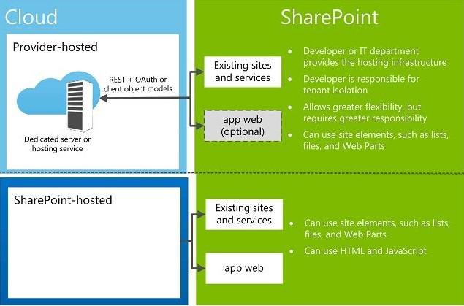
Add-in Hosting Options
Notes:
Following are some of the benefits of and considerations for these two scenarios:
Provider-Hosted with Remote Components Outside the Firewall
Benefits:
This approach enables you to use JavaScript and SharePoint JavaScript client APIs, or the SharePoint REST/OData Web service.
This approach enables you to use SharePoint JavaScript cross-domain library for authorization.
Consideration: This approach places responsibility on the development team for maintaining the remote site and for managing tenancy isolation among the customers that are using the add-in.
Provider-Hosted with Remote Components Inside the Firewall
Benefits:
This approach enables you to:
Use any programming languages that you wish.
Interact with a SharePoint site by using one of the SharePoint client object models or its REST/OData-based web service.
Use the OAuth protocol for add-in authentication and authorization.
Consideration: This approach places on the development team the responsibility to provide a packaging and installation system for the remote components.
For more information, see How to: Create a basic provider-hosted Add-in for SharePoint (http://msdn.microsoft.com/en-us/library/fp142381.aspx)

Slide 16
Notes (Continued)
Notes:
add-in does not have all the permissions that are requested by the add-in, then the user cannot install the add-in. By giving each add-in its own domain, SharePoint can reliably identify requests made by the add-in and verify the permissions of the add-in.
For more information about add-in permissions, see Add-in permissions (http://msdn.microsoft.com/en-us/library/fp179922.aspx#Add-inPermissions)
Cross-Domain Scripting Security:
Modern browsers support a same origin policy with regard to JavaScript method calls. By deploying each add-in for SharePoint to its own domain, SharePoint takes advantage of the browser's same origin policy to help ensure that JavaScript in the add-in for SharePoint cannot execute any JavaScript from any other domain (including the domain in which, from the end-user's perspective, the add-in is installed).
SharePoint also provides a means of safely overcoming the limits of the policy. Among other things, this enables the remote components of an add-in for SharePoint to query data from any website in the common parent tenancy of the host and Add-in Webs.
For more information, see How to: Access SharePoint 2013 data from remote Add-ins using the cross-domain library (http://msdn.microsoft.com/en-us/library/fp179927.aspx)

Slide 17
SPFx Solutions vs. Add-ins
SPFx Solutions
SPFx is the recommended development model for SharePoint user interface extensibility
The SharePoint Framework does not run in an iFrames so it can more seamlessly run in the context of the page with the full power of the user viewing it
Organizations can choose to have their SPFx web parts deployed to the Microsoft 365 public CDN, Azure storage, or a privately-owned web server.
Add-ins
Requires a lot more infrastructure even when a simple user interface customization is needed
They run in their own domain (App Web or provider-hosted web) within an Iframe on the page which prevents the add-in from gaining the user context from the rest of the page
iFrames can at times be not responsive, which results in the rendered webpage not being as fluent on a mobile phone or alternate screen sizes
Add-ins are limited to the permissions that the add-in was granted at install time, which can make add-ins a safer option for scenarios where an admin acquires an add-in from a third party, and it also allows Microsoft to have a Store from where you can download add-ins
Notes:
SharePoint Add-ins, previously known as SharePoint Apps and introduced in SharePoint 2013, have been one of the only available options of adding customizations to SharePoint Online in a supported and governed way. However, SharePoint Add-ins require a lot more infrastructure than necessary in many cases where a simple user interface customization is needed.
SharePoint Add-ins come in two flavors: SharePoint-hosted and provider-hosted. SharePoint-hosted add-ins have been one of the ways of executing client-side code in SharePoint in a supported way, but as said require a lot more effort than necessary to just include a simple client-side (JavaScript) web part. In many cases SharePoint-hosted add-ins were built just to deploy artifacts, such as lists and web parts, onto a SharePoint site. These add-ins live in a "special" site called the App Web, which is a site with limited features.
Provider-hosted add-ins, on the other hand, are add-ins that are executed remotely from SharePoint (Online) and can leverage server-side code as well as client-side code. This has a benefit for ISVs that want to protect their intellectual property/code/logic and for scenarios that can't be executed client-side by using JavaScript, such as long-running, calculation-heavy operations or access to remote data that cannot be achieved by using client-side scripting.
The primary advantage of add-ins is isolation: because the actual code is not executed in the SharePoint site browser, cross-site scripting protections prevent the add-in from getting the same access as the user has. Add-ins are limited to the permissions that the add-in was granted at install time. This makes add-ins a safer option for scenarios where an admin acquires an add-in from a third party, and it also allows Microsoft to have a Store from where you can download add-ins.
The SharePoint Framework works side-by-side with both SharePoint-hosted and provider-hosted add-ins, but can also be used as an alternative in scenarios where only client-side scripting is required. For example, add-ins can add app parts to the site where they are hosted. These app parts are similar to web parts, but instead of running in the context of the page, they run in their own domain (App Web or provider-hosted web) within an Iframe on the page. This prevents the add-in from gaining the user context from the rest of the page.
The SharePoint Framework, on the other hand, does not run in an Iframe. Thanks to this, it can more seamlessly run in the context of the page with the full power of the user viewing the part. This is the key to enabling it to run with rich functionality, but at the same time this means that it does not have the same level of security controls as add-ins. SharePoint Framework solutions are due to this also being referred to as full trust client-side solutions. Iframes suffer from the problem that they are not responsive, which results in the rendered webpage not being as fluent on a mobile phone or alternate screen size.
The SharePoint Framework solutions do not, at the time of writing, have a store where you can download and install solutions, due to the security aspect mentioned earlier. On the other hand, in many scenarios, using the user's context is a wanted scenario where SharePoint Framework could be used instead.

Slide 18
App Catalog - Provision and Configurations
Notes:
Let’s have a look at different possibilities for deploying your Internal build Add-Ins.

Slide 19
Tenant App Catalog
An app catalog is needed in order to deploy SPFx web part solutions and Add-ins to SPO sites
Provides storage and access to internally developed SPFx Solutions and Add-ins
SharePoint Online admin provisions the App Catalog site
It is the first step toward managing SPFx solutions and Add-ins for your SharePoint Online environment
Only one App Catalog per tenant (Tenant wide App Catalog)
Notes:
Use the App Catalog to make custom business add-ins available for your SharePoint Online environment.
As a SharePoint Online admin, you can create an App Catalog site to make internally developed custom Add-ins available for users to install when they browse Add-ins under the From Your Organization filter on the Site Contents page. Site owners can then add these Add-ins to customize sites with specific functionality or to display information.
After an App Catalog site has been created, you can use it to upload any custom Add-ins that your organization has developed. Uploading custom Add-ins is not more complicated than uploading a document to a library and setting some properties. You can also use the App Catalog site to, for example, install custom or third-party Add-ins on sites for users (also called Add-in deployment). You can also manage Add-in requests from users.
Step 1: Create an App Catalog Site
Creating an App Catalog site is the first step in managing Add-ins for your SharePoint Online environment. Even if you do not plan to make internal custom Add-ins available, you will not be able to do things like change the purchase settings for the SharePoint Store until you create an App Catalog site. You can have only one App Catalog site per SharePoint Online tenant.
Sign in to Microsoft Microsoft 365 admin center with your SharePoint Online admin user name and password.
Go to Admin > SharePoint.
Click More Features on the left, then click Open under Apps
Select App Catalog and then select Create a new App Catalog site, and then click OK
On the Create App Catalog Site Collection page, enter the required information, and then click OK
After the App Catalog site is created, you can browse to it within the SharePoint admin center by clicking More Features > Apps/Open > App Catalog. The App Catalog site will have a Document library for Add-ins for Office and a Document library for Add-ins for SharePoint, as well as a list that tracks Add-in requests from site users.

Slide 20
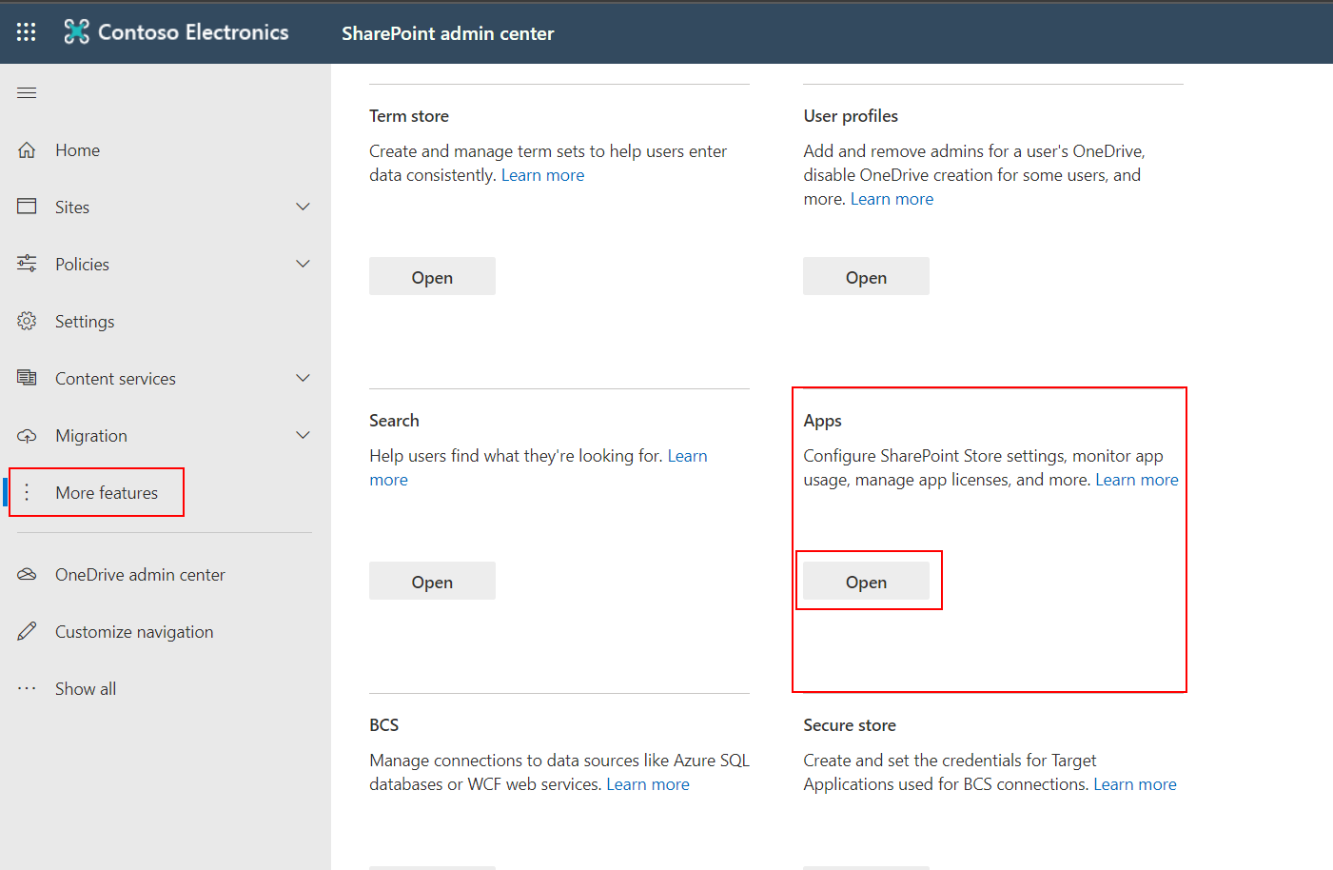
App Settings
The Apps settings within the SharePoint Online admin center allow you to:
Provision a Tenant wide add-in (App) catalog,
Purchase and monitor add-ins,
Control access to add-ins,
Manage licenses for add-ins

Slide 21
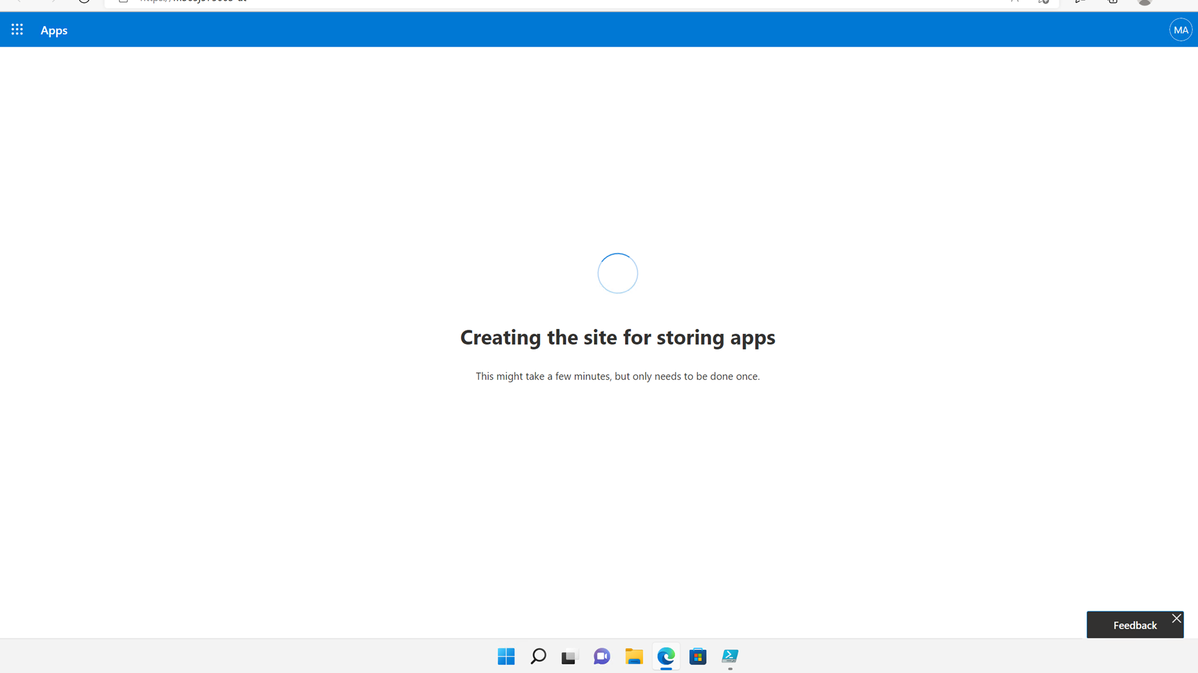
Create Tenant App Catalog
Notes:
Note: In Microsoft 365, the only option to create an App Catalog is to select the first option Create a new App catalog site.
In Microsoft 365, the App Catalog site template is not available in the template drop-down list when creating a new site collection, so there is no way to pre-create an App Catalog site collection and point to it when creating an App Catalog.
So the Enter a URL for an existing App catalog site will not work.
Demo Steps:
In App Catalog Site, select Create a new App catalog site, and then click OK.
On the Create App Catalog page, in the Title box, type a title for the App Catalog site.
In Description, type the description for the site.
In URL, fill in the URL to use for the site.
In Primary Site Collection Administrator, in the User Name box, type the name of the user, who will manage the catalog.
Only one user name can be entered. Security groups are not allowed.
In End Users, in the Users/Groups box, type the names of the users or groups that you want to be able to browse the catalog.
Note: Added users or groups have read access to the App Catalog site. You can add multiple user names and security groups. Users must be added as End Users to be able to browse the App Catalog from their site collections.
In Select a quota template, select the quota template to use for the site.
Click OK.

Slide 22
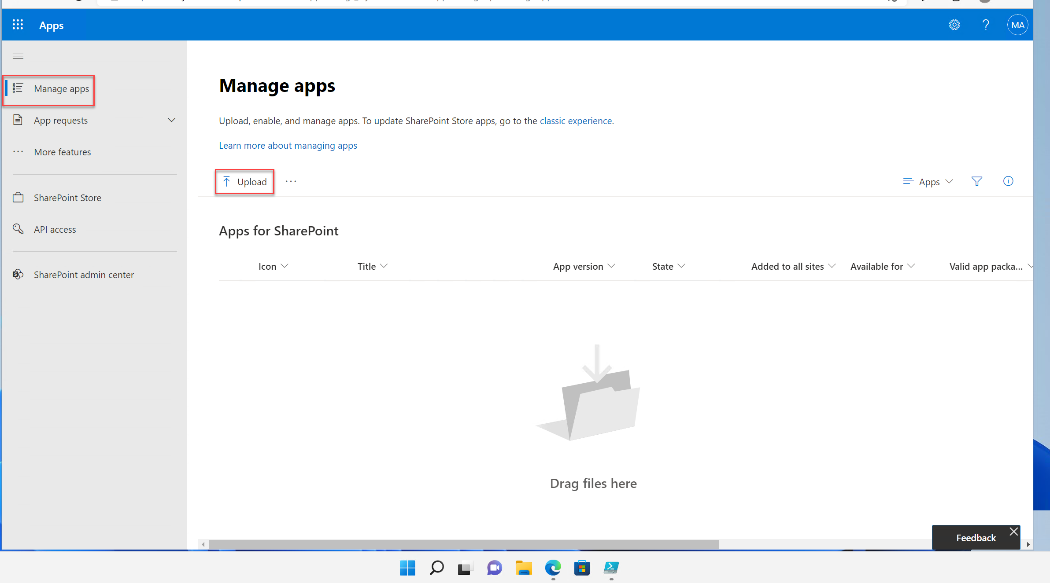
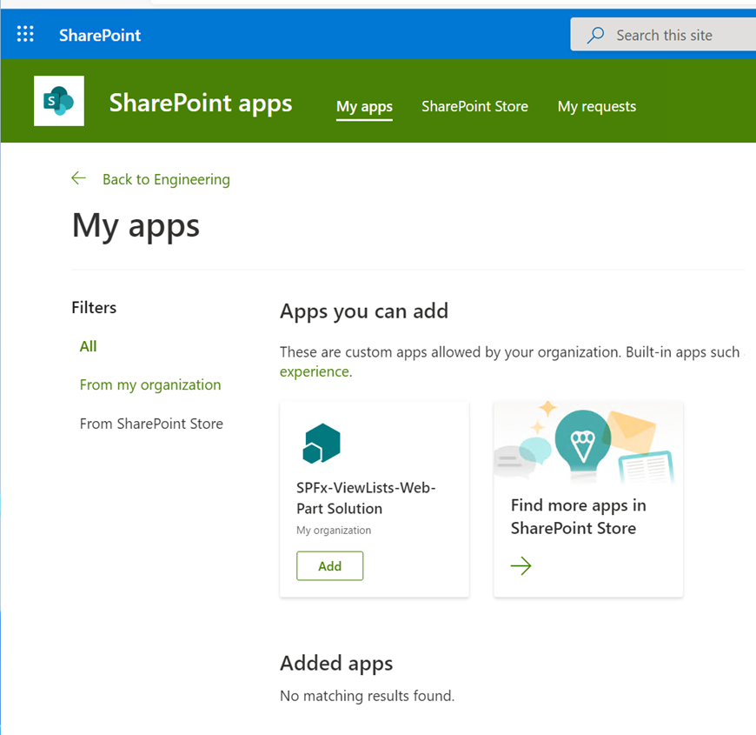
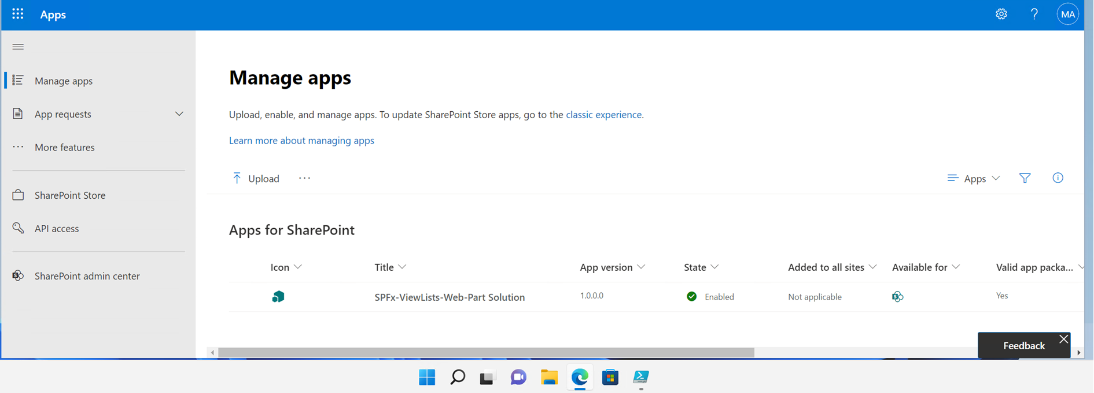
Tenant App Catalog Home Page
Notes:
In the image on the slide, point out the default tiles for distributing Add-ins for SharePoint and Office, and managing requests for Add-ins.
All add-ins and SharePoint Framework solutions had to be managed centrally ideally by SharePoint Online Administrators.
Any deployed package is visible on all site collections
Tenant administrators can decentralize the management of customizations to the specific sites.
Once enabled, site collection administrators can deploy SharePoint add-ins and SharePoint Framework solutions that will be available only in that particular site collection.

Slide 23
Site Collection App Catalog
Tenant administrators can decentralize the management of add-ins and SharePoint Framework solutions to specific sites.
Provides storage and access to internally developed custom add-ins specific to a single site.
SharePoint Online Admin enables App Catalog on specific sites.
Must create a Tenant App Catalog before you can enable Site Collection App Catalog.
Notes:
While it might be enough for many scenarios where you will only create Tenant wide App catalog but in some case you as a SharePoint Administrator has to decentralize the management of customizations in your organization. In that case, you will allow individual sites to have their own customizations deployed yet securing you environment.
This can be achieved by provisioning a site collection level App catalog

Slide 24
Why site collection App catalog?
With Tenant wide App Catalog
All add-ins and SharePoint Framework solutions had to be managed centrally ideally by SharePoint Online Administrators.
Any deployed package is visible on all site collections.
With Site Collection App Catalog
Tenant administrators can decentralize the management of customizations to the specific sites.
Once enabled, site collection administrators can deploy SharePoint add-ins and SharePoint Framework solutions that will be available only in that particular site collection.

Slide 25
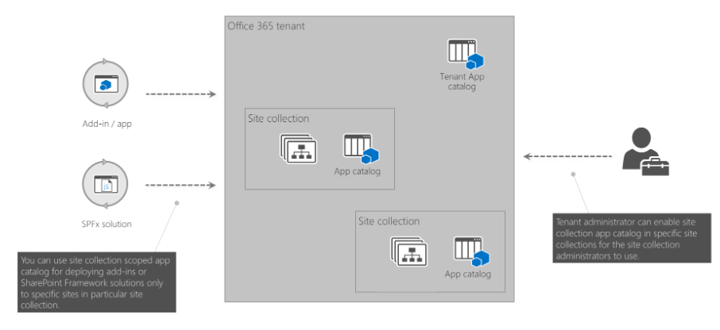
Site Collection App Catalog for Scoped Deployments
Notes:
In your Microsoft 365 tenant you have a tenant app catalog. Solutions deployed to this app catalog, can be installed in any site collection in the tenant. Tenant administrators can choose to enable site collection app catalogs on specific site collections. Solutions deployed to the site collection app catalogs can only be installed in that particular site collection.

Slide 26
Configure Site Collection App Catalog
Configure and manage site collection App Catalogs using the SharePoint Online Management Shell.
You need to have SharePoint Online Administrator Permissions to configure Site Collection App Catalog.
To enable a site collection App Catalog use the Add-SPOSiteCollectionAppCatalog cmdlet
To disable the site collection App Catalog in your site collection use the Remove-SPOSiteCollectionAppCatalog cmdlet
Notes:
Add-SPOSiteCollectionAppCatalog cmdlet passing the site collection where the app catalog should be created as the -Site parameter.
Remove-SPOSiteCollectionAppCatalog cmdlet passing the site collection where the app catalog should be disabled as the -Site parameter

Slide 27
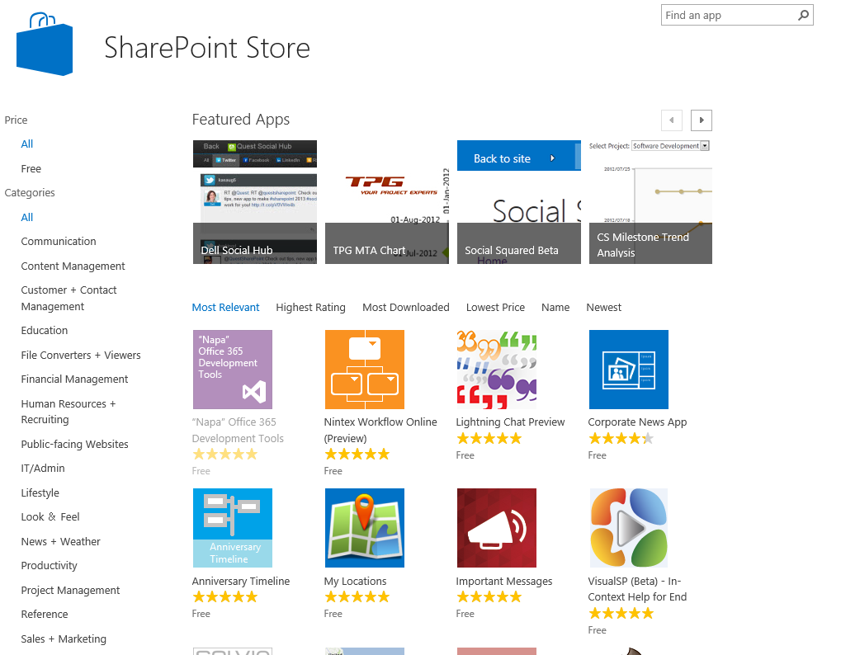
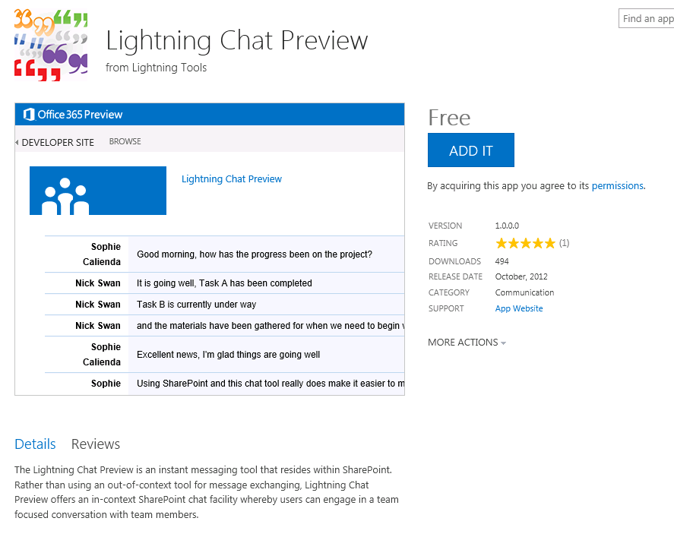
SharePoint Store
A public marketplace where users can request or purchase add-ins for SharePoint Online
To add an add-in to a site, you must have at least Full Control permissions for that site
SharePoint Framework solutions do not have a Store where you can download and install solutions
Notes:
The SharePoint Store is a public marketplace that you can access directly from a SharePoint site, where you can buy Add-ins from third-party developers for personal or organizational use. An Add-in for SharePoint is a small, easy-to-use, stand-alone application that performs a specific task or meets a business need. You can add Add-ins to your site to customize it with specific functionality or to display information.
To add an Add-in to a site, you must have Full Control permissions for that site. If you are a Site Owner, you already have this permission.
You must have a Microsoft account (also known as LiveID) to install an Add-in from the SharePoint Store.
A Microsoft account is not the same as an Microsoft 365 account. If you use Microsoft 365, and you do not already have a Microsoft account, you can sign up for one using your Microsoft 365 email address. For more information, see: http://windows.microsoft.com/en-us/windows-live/sign-up-create-account-how.
Some Add-ins in the SharePoint Store are free, whereas others are available for purchase.
If your admin has not configured your site to allow users to buy Add-ins, you might still be able to request an Add-in.
The person who manages the App Catalog site in your organization can approve or deny requests for purchasing Add-ins. Once an Add-in request is approved, this person must then install the Add-in. It is this person, who must have a Microsoft Account in order to do this.
Once an Add-in request is approved and the Add-in Manager installs it, the users that requested the Add-ins do not need a Microsoft account to use the Add-ins from the SharePoint Store.
The SharePoint Framework solutions do not, at the time of writing, have a store where you can download and install solutions, due to the security aspect mentioned earlier. On the other hand, in many scenarios, using the user's context is a wanted scenario where SharePoint Framework could be used instead.

Slide 28
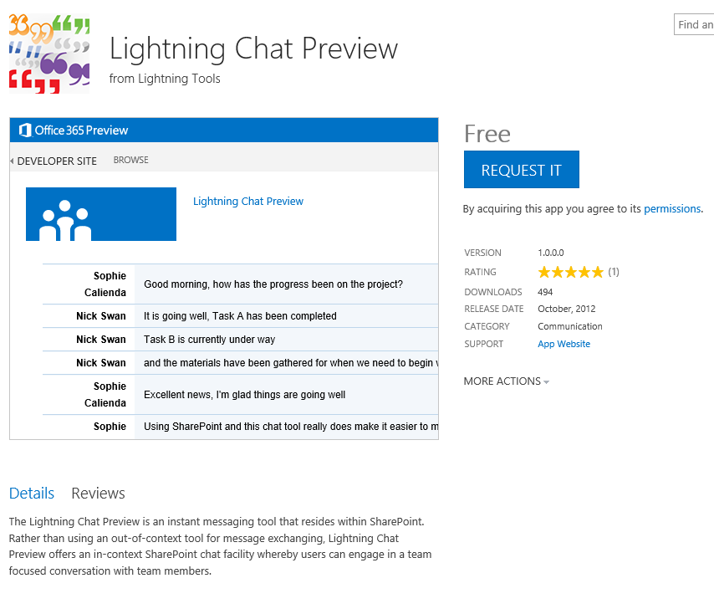
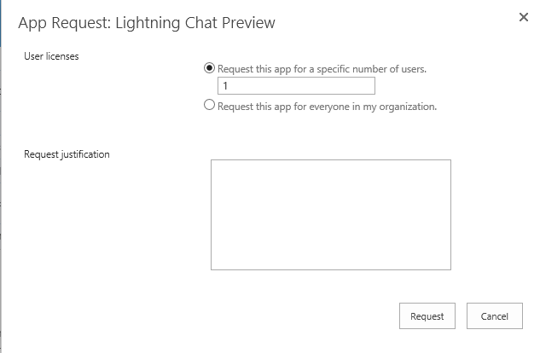
Add-in Request
When SharePoint Store App Purchases is Disabled then users can still see the Add-ins, but must submit a request for them
Notes:
When users request an Add-in for SharePoint from the SharePoint Store, users can request a specific number of licenses and provide a justification for the purchase of the Add-in for SharePoint. Submitted requests are added to the Add-in Requests list in the App Catalog of the
Web Application that contains a user’s site collection. The Add-in request includes the following fields:
Requested by—The user name of the person requesting the Add-in for SharePoint
Title—The title of the Add-in for SharePoint
Seats and Site License—The number of licenses the user requested for that Add-in for SharePoint
Justification—The reason why the Add-in for SharePoint would be useful for the organization
Status—By default, the status is set to New for new requests. The person who reviews the request can change the status to Pending, Approved, Declined, Withdrawn, Closed as Approved, or Closed as Declined.
View Add-in Details—A link to the Add-in details page in the SharePoint Store
Approver Comments—The person who reviews the request can add comments for the requestor.

Slide 29
Notes Continued
Notes:
When users request an Add-in for SharePoint from the SharePoint Store, users can request a specific number of licenses and provide a justification for the purchase of the Add-in for SharePoint. Submitted requests are added to the Add-in Requests list in the App Catalog of the web application that contains a user’s site collection. The Add-in request includes the following fields:
Requested by: The name of the user requesting the Add-in for SharePoint
Title: The title of the Add-in for SharePoint
Seats and Site License: The number of licenses the user requested for that Add-in for SharePoint
Justification: The reason why the Add-in for SharePoint would be useful for the organization
Status: By default, the status is set to New for new requests. The person, who reviews the request, can change the status to Pending, Approved, Declined, Withdrawn, Closed as Approved, or Closed as Declined.
View Add-in Details: A link to the Add-in details page in the SharePoint Store
Approver Comments: The person who reviews the request can add comments for the requestor.
To view and manage Add-in requests from the SharePoint Store Settings page:
Verify that the user account that is performing this procedure is a member of the Global Admins group and is a member of the site Owners or Designers group for the App Catalog.
In SharePoint Online admin center, on the Add-ins page, click Configure Store Settings.
In the Add-in Requests section, click Click here to view Add-in requests.
The Add-in Requests list in the App Catalog site opens.
Select a request in the list, and then click Edit.
Review the details of the request.
Note: At this time, the View Add-in details link in the request details opens the SharePoint Store home page, instead of the details page for the Add-in. Search for the Add-in in the SharePoint Store to find more information about the Add-in.
Change the Status to the appropriate value.
Approved—if you want the user to be able to purchase the Add-in.
Declined—if you do not want to allow the purchase.
Add comments in the approver Comments box, and then click Save.
To view a request, requestors can go to the Add an Add-in page in their site collection, and then click Your Requests.

Slide 30
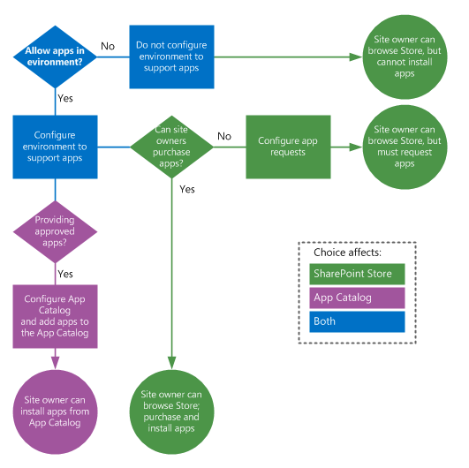
Governance Decisions for Add-ins
What is the extent to which you want to use add-ins?
What are the policies for using add-ins with your organization?
Notes:
Governance: Determine the Add-in for SharePoint policy for your organization.
The first decision about Add-ins for SharePoint is the extent to which you want to use them in your organization and the policy for using them. The following questions can help you frame your discussion about your policy:
Do you want site owners to be able to install and use Add-ins for SharePoint?
If so, keep reading and shaping your policy.
If not, then you can use the settings in the SharePoint Store to control whether site owners can purchase Add-ins from the SharePoint Store. You cannot block site owners from viewing the SharePoint Store. However, you can prevent them from purchasing or downloading Add-ins for SharePoint. If you choose to prevent site owners from installing Add-ins for SharePoint from the SharePoint Store, you should create a policy statement and advise site owners that you have chosen not to support Add-ins for SharePoint. Otherwise, the only message to site owners will be an error when they try to install an Add-in for SharePoint.
Do you want to restrict or control the Add-ins for SharePoint that site owners can install and use?
If so, you can do one or both of the following:
Set up an App Catalog to provide a set of Add-ins for SharePoint that site owners can install and use.
Use the Add-in Request feature to control the purchasing and licensing of Add-ins for SharePoint.

Slide 31
Knowledge Check
As a SharePoint Online administrator, what is one of the first things to do to manage SharePoint Framework solutions and Add-ins?
By default, where will SPFx web part assets will be stored and served from?
Provision an App Catalog for your tenant
Each web part’s assets are stored in, and served from, their own folder within the /ClientSideAssets library of the App Catalog site
What is the recommended development model for SharePoint user interface extensibility?
SharePoint Framework

Slide 32
Summary
In this lesson, you learned about:
SPFx client- side solutions and Add-ins
The configuration settings and options for SPFx client-side solutions and Add-ins
How to provision an App Catalog
The importance of managing SPFx solutions and add-ins within your SharePoint Online environment and ways to control your end user’s ability to download and use add-ins from the SharePoint Store

Slide 33
Lab
Administrating SharePoint Online SPFx client-side solutions

